Slide 1





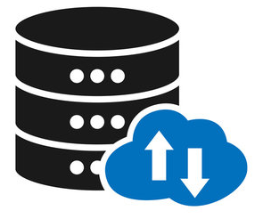





0. Simple web stack
Router
Ask for the IP
Mapped to
www. foobar.com
HTTP response
A Record
@maps to IP 8.8.8.8
www.foobar.com maps to @
User/Client
IP request
The IP is 8.8.8.8
www. foobar.com
Server IP 8.8.8.8
LAMP stands for Linux, Apache, MySQL, and PHP
Web Server Nginx
Application Server
Application Files
Database
Database Server MySQL

Slide 2
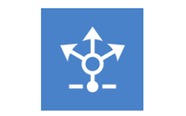
1. Distributed web infrastructure
LAMP stands for Linux, Apache, MySQL, and PHP
User/Client
Application Server
Application Files
Server Alpha
Web Server Nginx Alpha
www. foobar.com
Database
Database Server MySQL
HAPorxy
IP request
HTTP response
LAMP stands for Linux, Apache, MySQL, and PHP
Load Balancer
Router
Ask for the IP
Mapped to
www. foobar.com
Application Files
The IP is 8.8.8.8
Application Server
Server Beta
Web Server Nginx Beta
A Record
@maps to IP 8.8.8.8
www.foobar.com maps to @
Database
Database Server MySQL

Slide 3
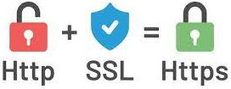


2. Secured and monitored web infrastructure
LAMP stands for Linux, Apache, MySQL, and PHP
User/Client
Application Server
Application Files
Server Alpha
Monitor client
Web Server Nginx Alpha
Firewall
www. foobar.com
Database
Database Server MySQL
HAPorxy
IP request
HTTP response
LAMP stands for Linux, Apache, MySQL, and PHP
Load Balancer
Router
Ask for the IP
Mapped to
www. foobar.com
Firewall
The IP is 8.8.8.8
Application Server
Application Files
Web Server Nginx Beta
Server Beta
Monitor client
A Record
@maps to IP 8.8.8.8
www.foobar.com maps to @
Database
Database Server MySQL

